Slide 1

Unit : V
UNIT 5
INTRODUCTION TO SELENIUM
Prof. Rahul Pawar,
Assistant Professor, School of CS & IT,
MCA Department,
Knowledge Campus

Slide 2
INTRODUCTION TO SELENIUM
Unit : V
Selenium is a web Automation tool which can used to perform testing ONLY on Web Applications not Desktop based applications.
Selenium is a free (open source) automated testing suite for web applications across different browsers and platforms.
Testing done using Selenium tool is usually referred as Selenium Testing.
Selenium is not just a single tool but a suite of software's, each catering to different testing needs of an organization. It has four components.
Selenium Integrated Development Environment (IDE)
Selenium Remote Control (RC)
WebDriver
Selenium Grid

Slide 3
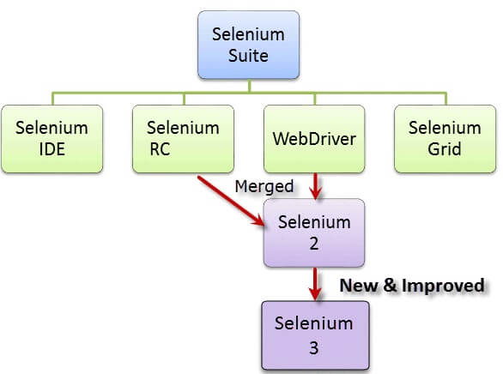
Unit : V

Slide 4
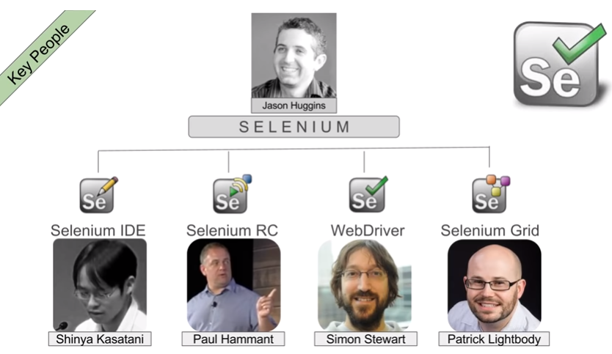
Since Selenium is a collection of different tools, it had different developers as well. Below are the key persons who made notable contributions to the Selenium Project
Unit : V

Slide 5
Selenium IDE
Unit : V
Selenium IDE (Integrated Development Environment) is a prototyping tool for building test scripts.
It is a Firefox and Chrome plugin and provides an easy-to-use interface for developing automated tests.
Selenium IDE has a recording feature, which records user actions as they are performed and then exports them as a reusable script in one of many programming languages that can be later executed.
Selenium IDE doesn’t provide iteration or conditional statements for test scripts.
Selenium IDE is simply intended as a rapid prototyping tool.
Operation System Support – Windows, Mac OS, Linux

Slide 6
Selenium Remote Control (RC)
Unit : V
Selenium RC solves the limitations of Selenium IDE.
It supports various programming languages like (Java,PHP,Perl,Python, Ruby) and leverages the programming languages to achieve logic required in test cases like conditional statements, iterations, exception handling, test reporting, database testing, capturing screen shots of failed tests, test case grouping.
Selenium RC aka Selenium 1
A test tool that allows you to write automated web application UI tests in any programming language against any HTTP website.
Operating System Support – Windows, Mac OS, Linux, Solaris Browser Support – Mozilla Firefox, Internet Explorer, Google Chrome, Safari, Opera

Slide 7
Selenium WebDriver
Unit : V
Selenium WebDriver AKA Selenium 2 is a browser automation framework that accepts commands and sends them to a browser.
It is implemented through a browser-specific driver. It controls the browser by directly communicating with it.
Selenium WebDriver supports Java, C#, PHP, Python, Perl, Ruby.
Designed to provide a simpler, more concise programming interface in addition to addressing some limitations in the Selenium-RC API
Developed to better support dynamic web pages where elements of a page may change without the page itself being reloaded
Operating System Support – Windows, Mac OS, Linux, Solaris Browser Support – Mozilla Firefox, Internet Explorer, Google Chrome 12.0.712.0 and above, Safari, Opera 11.5 and above, Android, iOS, HtmlUnit 2.9 and above

Slide 8
Selenium Grid
Unit : V
Selenium Grid is a tool used together with Selenium RC to run tests on different machines against different browsers in parallel.
This has two advantages. First, if you have a large test suite, or a slow-running test suite, you can boost its performance substantially by using Selenium Grid to divide your test suite to run different tests at the same time using those different machines.
Also, if you must run your test suite on multiple environments you can have different remote machines supporting and running your tests in them at the same time.
In each case Selenium Grid greatly improves the time it takes to run your suite by making use of parallel processing.
In Selenium 2.0, the supported browsers vary depending on whether you are using Selenium-WebDriver or Selenium-RC.

Slide 9
TestNG
Unit : V
TestNG is an automation testing framework in which NG stands for "Next Generation".
TestNG is designed to cover all categories of tests: unit, functional, end-to-end, integration, etc., and it requires JDK 5 or higher.
TestNG is a testing framework inspired from Junit(JUnit is a unit testing framework for the Java programming language) and Nunit(NUnit is an open-source unit testing framework for Microsoft .NET), but introducing some new functionalities that make it more powerful and easier to use.
Using TestNG you can generate a proper report, and you can easily come to know how many test cases are passed, failed and skipped.

Slide 10
Key features of TestNG
Unit : V
Generate the report in a proper format including a number of test cases runs, the number of test cases passed, the number of test cases failed, and the number of test cases skipped.
Multiple test cases can be grouped more easily by converting them into testng.xml file. In which you can make priorities which test case should be executed first.
The same test case can be executed multiple times without loops just by using keyword called 'invocation count.'
Using testng, you can execute multiple test cases on multiple browsers, i.e., cross browser testing.
Annotations used in the testing are very easy to understand ex: @BeforeMethod, @AfterMethod, @BeforeTest, @AfterTest.

